Slide 1
Mentoring Mondays
Measurement & Computation Errors
Jerry Mahun, PLS
Retired and a burden on my wife
jerry.mahun@gmail.com
jerrymahun.com
Tonight
I. Numbers
  A. Type
  B. Communication
  C. Sig Fig
II. Measurement Errors
  A. Quality
  B. Error Tenets
  C. Error Sources
  D. Error Types
  E. Behavior
  F. Minimizing
III. Random Errors
  A. Basic Analysis
  B. Error Propagation
IV. Least Squares Adj
  A. Compared to Simplified Adj
  B. Complex Networks
  C. Random Errors Only
  D. Redundancies
  E. Weights
  F. Linear/Non-Linear
  G. Adjustment Statistics

Slide 2
B. Error Propagation; 1. Simple
  When combining measurements compute a third value, how do their errors affect the result?
    It depends on how they are combined.
  a. Error of a Sum
    Adding or subtracting values which are subject to errors.
      Example: A soil specimen is divided into three sample parts which are separately weighed. What is the error in the soil’s total weight?
Soil sample | Weight
1 | 56.2 gr ±0.15 gr
2 | 28.9 gr ±0.21 gr
3 | 41.6 gr ±0.11 gr
Total wt = 127.6 gr ± ______ gr

Slide 3
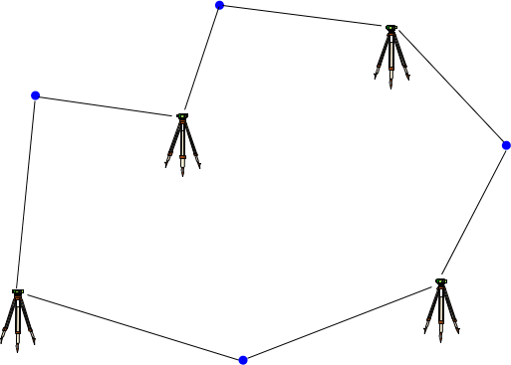
B. Error Propagation; 1. Simple
  b. Error of a Series
      The same error occurring multiple times.
      Example: Each time they set up a level, a survey crew can determine an elevation difference to ±0.015 ft. What is their expected misclosure on this loop?

Slide 4
B. Error Propagation; 1. Simple
  c. Error of a Product
    Two values with errors are multiplied or divided.
      A±E_{A}, B±E_{B} ⇨ A x B ±?
      Example: What is error in a rectangular parking lot’s area based on the measurements of its sides?
186.1’±0.83’
97.6’±0.57’

Slide 5
B. Error Propagation; 2. Combined
  a. Distance
    Manufacturer states an accuracy (MSA) for distance between the instrument and reflector, eg, ±(3 mm + 3 ppm)
    There are centering errors at the inst (E_{tsi}) and ref (E_{ref})
E_{ref}
MSA: ±(C+P)
E_{tsi}
D

Slide 6
B. Error Propagation; 2. Combined
  a. Distance
    Example:
    TSI setup error: ±0.005 ft; handheld reflector centering: ±0.01 ft; 712.36 ft measured distance. MSA: ±(3 mm + 3 ppm)
See workbook for comps
±0.01 ft
MSA:
±(3 mm + 3 ppm)
±0.005 ft
D

Slide 7
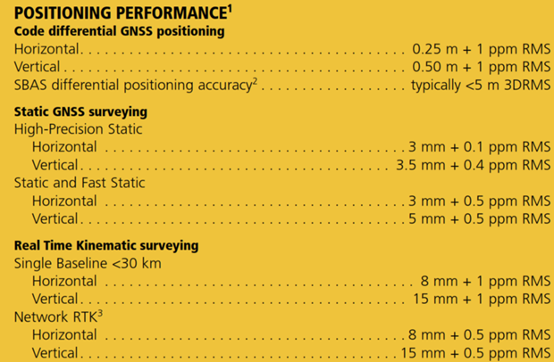
B. Error Propagation; 2. Combined
  a. Distance
    Also applies to GPS H and V components
H_{base}: base centering error
H_{rov}: rover centering error
V_{base}: base elev error
V_{rov}: rover elev error
H_{rov}
V_{rov}
MSA: ±(C_{h}+P_{h})
±(C_{v}+P_{v})
H_{base}
D
V_{base}

Slide 8
B. Error Propagation; 2. Combined
  b. Angle
  Angles are more complicated because there are three points and a number of random error sources:
    Instrument resolution
    Instrument centering
    Target centerings at BS and FS points
    Target sightings
    Distances to BS and FS points
    Number of times the angle is measured.
E_{BS}
D_{BS}
TSI
resolution;
centering
E_{FS}
D_{FS}

Slide 9
B. Error Propagation; 2. Combined
  b. Angle
  Each source has its own error propogation.
    These are combined to determine the total expected angle error.
TSI Point & Read
E_{BS}
D_{BS}
D
TSI Centering
TSI
resolution;
centering
E_{FS}
Target Centering
D_{FS}
Angle Error

Slide 10
B. Error Propagation; 2. Combined
  b. Angle
  Example
    A TSI with DIN spec of 2 sec;
      centering error: ±0.005 ft
    BS & FS centering errors: ±0.005 ft & ±0.01 ft;
    BS & FS dists: 176 ft & 243 ft.
    Angle was measured 2 D/R to get 123°30’10”
    What is the expected error in the angle?
E_{BS}
D_{BS}
D
TSI
resolution;
centering
E_{FS}
D_{FS}
See workbook for comps

Slide 11
Summary
Error Budget Management
  Errors can’t be eliminated but effects can be minimized
  Systematic errors
    Procedure
    Adjustment
    Computation
  Random Errors
    Appropriate equipment
    Knowledgeable personnel
    Careful measuring techniques
Understanding the origin of and how errors behave ensures accurate and reliable measurement results.

Slide 12
A. Compared to Simplified Adjustments; 1. Adv/Disadv
  Advantages
    Models random errors better
    Able to deal with multiple unknowns simultaneously
    Easily incorporate redundant measurements – the more the merrier
    Can easily use mixed quality measurements - weights
    Can generate statistics for
      overall adjustment
      individual unknowns
  Disadvantages
    Computation intensive
    Statistics overload
    Easy to misuse
Most
squares
Least
squares

Slide 13
B. Building Complex Networks
BMA
806.52'
BMD
+8.91’
824.04'
Simple network adjustment is possible
824.07’
+1.75’
Q
T
+6.89’
815.43
822.32
Example: Even distribution
  Closure error at BM D = 814.07-824.04 = +0.03
  Corr’n per elev = -0.03/3 = -0.01
    Adj Elev_{Q} = 815.43+(1)(-0.01) = 815.42
    Adj Elev_{T} = 822.32+(2)(-0.01) = 822.30
    Adj Elev_{BM D} = 824.07+(3)(-0.01) = 824.04 check

Slide 14
B. Building Complex Networks
BMA
806.52'
BMD
+8.91’
824.04'
Simple network adjustment is possible
824.07’
+1.75’
Q
T
+6.89’
815.43
822.32
Example: Even distribution
  Closure error at BM D = 814.07-824.04 = +0.03
  Corr’n per elev = -0.03/3 = -0.01
    Adj Elev_{Q} = 815.43+(1)(-0.01) = 815.42
    Adj Elev_{T} = 822.32+(2)(-0.01) = 822.30
    Adj Elev_{BM D} = 824.07+(3)(-0.01) = 824.04 check
Drawback of Simple Adj:
  Random errors are treated systematically.

Slide 15
B. Building Complex Networks
BMA
806.52'
BMD
-8.66’
+8.91’
824.04'
Simple network adjustment is cumbersome.
824.07’
+1.75’
815.38
Q
T
+6.89’
815.43
822.32
Point Q has two different elevations.
How do we apply a simple adjustment so point Q has only one elevation?

Slide 16
B. Building Complex Networks
BMA
806.52'
BMD
+15.82’
824.04'
-8.66’
+8.91’
Simple network adjustment is not possible.
824.07’
+1.75’
815.38
Q
822.34
+6.89’
815.43
T
822.32
Point Q has two different elevations.
Point T has two different elevations.
How do we apply a simple adjustment so both points each have a single elevation?

Slide 17
C. Random Errors Only
  Mistakes and systematic errors must be eliminated/compensated.
  Mistake: effect can be spread into other measurements
    Residual sizes and distribution.
R
BMA
Mistake in line BMB-Q:
Affects other lines touching Q.
Lines into R not affected
BMD
Q
BMB
BMC

Slide 18
C. Random Errors Only
  Mistakes and systematic errors must be eliminated/compensated.
  Mistake: effect can be spread into other measurements
    Residual sizes and distribution.
R
BMA
Mistake in line BMB-Q;
R & Q connected
Mistake affects:
  all lines touching Q
  line between Q & R
  possibly other lines touching R.
The more df, the harder to track down mistakes.
Most LSA software have blunder detection.
BMD
Q
BMB
BMC

Slide 19
C. Random Errors Only
  Systematic errors
    Residual sizes and distribution depend on:
      Error character: scale or additive constant
      Which measurements are affected
    Example: traverse misclosure
Incorrect temp & pressure in TSI
Wrong ppm multiplier for all lines – scale.
Incorrect refl constant
Each line changes the same additive amount regardless of length.

Slide 20
C. Random Errors Only
  Systematic errors
Original traverse data
Line |  |  | Distance
From | To | Azimuth | Unscaled | Scaled
A | B | 30 00 00 | 365.790 | 365.790
B | C | 325 33 52 | 354.520 | 354.520
C | D | 219 02 01 | 645.840 | 645.840
D | A | 104 12 35 | 437.640 | 437.640
Closure Error
Azimuth | Dist
320 22 41.39 | 0.099
Precision: 1/ | 18,145
Scale each distance by 1.01
Line |  |  | Distance
From | To | Azimuth | Unscaled | Scaled
A | B | 30 00 00 | 365.790 | 369.448
B | C | 325 33 52 | 354.520 | 358.065
C | D | 219 02 01 | 645.840 | 652.298
D | A | 104 12 35 | 437.640 | 442.016
Closure Error
Azimuth | Dist
320 22 41.39 | 0.100
Precision: 1/ | 18,145
Add 0.05 to each distance
Line |  |  | Distance
From | To | Azimuth | Unscaled | Scaled
A | B | 30 00 00 | 365.840 | 365.840
B | C | 325 33 52 | 354.570 | 354.570
C | D | 219 02 01 | 645.890 | 645.890
D | A | 104 12 35 | 437.690 | 437.690
Closure Error
Azimuth | Dist
335 41 27.17 | 0.121
Precision: 1/ | 14,946

Slide 21
D. Redundancies; 1. General
  Redundancy; aka Degree of freedom (df)
      df = m-n
        m: number of measurements
        n: number of unknowns
BMA
806.52'
m | 3
n | 2
df | 1
BMD
+8.91’
824.04'
+1.75’
Q
T
+6.89’
BMA
806.52'
m | 5
n | 2
df | 3
BMD
+15.82’
824.04'
-8.66’
+8.91’
+1.75’
Q
T
+6.89’

Slide 22

D. Redundancies; 1. General
  Measurements must be independent.
      Not changing conditions allows mistakes & systematic errors repeatition.
e_{FS}
LoS
LoS
e_{BS}
Horiz
Horiz
Leveling
From a single set up:
  (a) BS A and FS B
  (b) BS B and FS A
Collimation error does not compensate.
B
(a)
A
e_{BS}
LoS
LoS
e_{FS}
Horiz
Horiz
B
(b)
A

Slide 23
D. Redundancies; 1. General
  Measurements must be independent.
      Not changing conditions allows mistakes & systematic errors repeatition.
LoS
LoS
e_{BS}
e_{FS}
Horiz
Horiz
Leveling
As min, inst should be taken down & reset:
  (a) Balance BS & FS dists;
  BS A then FS B
  (b) Reset inst with BS/FS dists balanced;
  BS B then FS A
B
(a) Initial setup
A
LoS
LoS
e_{FS}
e_{BS}
Horiz
Horiz
B
(b) Reset
A

Slide 24
D. Redundancies; 2. Vertical Network – 1D
  In leveling, an observation between two points is Σ(BS) – Σ(FS).
BS
FS
BS
FS
BS
FS
tp
tp
2
1
BM Dog
How many observations are needed to determine elevations of points A and B?
A
B

Slide 25
D. Redundancies; 2. Vertical Network – 1D
  In leveling, an observation between two points is Σ(BS) – Σ(FS).
BS
FS
BS
FS
BS
FS
tp
tp
2
1
BM Dog
How many observations are needed to determine elevations of points A and B?
Two unknowns (Elev_{A} & Elev_{B}) so two observations are necessary.
Add a redundancy...
A
(1)
(2)
B

Slide 26
D. Redundancies; 2. Vertical Network – 1D
  Each unknown elevation must be connected to the network by at least two observations for redundancy.
BM Dog
BM Dog
(3)
(3)
A
A
(1)
m | 3
n | 2
df | 1
(1)
m | 3
n | 2
df | 1
(2)
(2)
B
B
True redundancy
Pseudo redundancy
  Point B has only one observation.

Slide 27
D. Redundancies; 3. Horizontal Network – 2D
  Each point in a horizontal network has two unknowns: N and E.
D
D
(8)
(7)
(6)
A
A
(1)
(2)
(5)
C
C
(3)
(4)
B
B
Traditional traverse
  Measure 4 angles and 4 distances: 8 obs
  Fix one point and one direction: 6 unk
  8-6 = 2 redundancies
  Simplified adj: Compass, Transit, or Crandall Rule
    ΣLat = 0
    ΣDep = 0
2 df allows 2 math checks

Slide 28
D. Redundancies; 3. Horizontal Network – 2D
  Adding redundancy....
D
D
D
A
A
A
8 dists
4 angles
8 dists
6 dists
4 angles
C
C
C
m | 10
n | 6
df | 4
m | 12
n | 6
df | 6
m | 8
n | 6
df | 2
B
B
B

Slide 29
D. Redundancies; 3. Horizontal Network – 2D
  Adding redundancy....
D
D
D
A
A
A
8 dists
4 angles
8 dists
6 dists
4 angles
C
C
C
m | 10
n | 6
df | 4
m | 12
n | 6
df | 6
m | 8
n | 6
df | 2
B
B
B
true
true
pseudo
Because each point has two unknowns, it must be connected to the network by at least three measuements for redundancy.

Slide 30
E. Weights; 1. Vertical – Leveling
  Distance
  Set ups
BS
FS
BS
FS
w_{jk} = 1/d_{JK}
n_{JK} = 3
w_{jk} = 1/3
BS
FS
tp
tp
K
J
d_{JK}
w_{kl} = 1/d_{KL}
n_{KL} = 2
w_{kl} = 1/2
BS
FS
BS
FS
L
K
tp
d_{KL}

Slide 31
E. Weights; 2. Horizontal
  w = 1/(σ²) = 1/(E²)
  Distances
  Angles & Directions
E_{ref}
MSA: ±(C+P)
E_{tsi}
D
E_{BS}
D_{BS}
TSI
resolution;
centering
E_{FS}
D_{FS}

Slide 32
F. Linear/Non-Linear; 1. Vertical
  An LSA minimizes the sum of the squares of the residuals of the observations: Σ(v²)=min
  Vertical
    Unknowns are elevations
    Measurements are simple addition and subtraction
      Elev_{B} = Elev_{A} + BS_{A} – FS_{B}
    Simple math means LSA is a direct solution of simultaneous equations.
BS
FS
BS
FS
L
K
tp
d_{KL}

Slide 33
F. Linear/Non-Linear; 1. Vertical
  To minimize Σ(v²), an equation including a residual must be created for each measurement.
BMA
806.52'
BMD
-8.66’
+8.91’
824.04'
+1.75’
Q
T
+6.89’

Slide 34
F. Linear/Non-Linear; 1. Vertical
  To minimize Σ(v²), an equation including a residual must be created for each measurement.
BMA
806.52'
BMD
-8.66’
+8.91’
824.04'
+1.75’
Q
T
+6.89’
Line
BMA-Q:
Q-T:
T-BMD:
BMD-Q

Slide 35
F. Linear/Non-Linear; 1. Vertical
  To minimize Σ(v²), an equation including a residual must be created for each measurement.
BMA
806.52'
BMD
-8.66’
+8.91’
824.04'
+1.75’
Q
T
+6.89’
Rearrange the equations in terms of their residuals
Line
BMA-Q:
Q-T:
T-BMD:
BMD-Q

Slide 36
F. Linear/Non-Linear; 1. Vertical
  To minimize Σ(v²), an equation including a residual must be created for each measurement.
BMA
806.52'
BMD
-8.66’
+8.91’
824.04'
+1.75’
Q
T
+6.89’
Square each residual equation and add them
The function must be minimized for each unknown.
Take the partial derivative with respect to each unknown elevation and set equal to 0.

Slide 37
F. Linear/Non-Linear; 1. Vertical
  To minimize Σ(v²), an equation including a residual must be created for each measurement.
BMA
806.52'
BMD
-8.66’
+8.91’
824.04'
+1.75’
Q
T
+6.89’
Take partial derivatives and simplify
Two equations in two unknowns

Slide 38
F. Linear/Non-Linear; 1. Vertical
  To minimize Σ(v²), an equation including a residual must be created for each measurement.
BMA
806.52'
BMD
-8.66’
+8.91’
824.04'
+1.75’
Q
T
+6.89’
Take partial derivatives and simplify
Elev_{Q} = 815.404’
Elev_{T} = 822.292’

Slide 39
F. Linear/Non-Linear; 1. Vertical
  If another measurement is added, its squared residual is added to the function.
BMA
806.52'
BMD
+15.82’
824.04'
-8.66’
+8.91’
+1.75’
Q
T
+6.89’
As before:
  Partial derivatives with respect to each unknown elevation are set equal to 0.
  Resulting simultaneous equations are solved to determine the unknown elevations.

Slide 40
F. Linear/Non-Linear; 2. Horizontal
  Unknowns are coordinates
  Measurements are angles and distances.
  Position determination requires trig which is non-linear.
  LSA solution uses coordinate variation
    Start with approximate coordinates
    Compute and apply corrections
    Repeat until corrections are below a threshold
D
A
C
B

Slide 41
F. Linear/Non-Linear; 2. Horizontal
  Distances
The residual is the difference between the measured distance and the distance computed from coordinates.
A
T
T’
D_{AT}
v_{at}
Four partial derivatives (one for each coordinate) of the residual squared:
dN_{A}, dE_{A}, dN_{T}, dE_{T} are corrections for the initial coordinates.

Slide 42
F. Linear/Non-Linear; 2. Horizontal
  Angles
F
The residual is the difference between the measured angle and the angle computed from coordinates.
Az_{AF}
b_{FAT}
T
Az_{AT}
T’
A
v_{fat}
Six partial derivatives (one for each coordinate) of the residual squared:
dN_{A}, dE_{A}, dN_{F}, dE_{F}, dN_{T}, dE_{T} are corrections for the initial coordinates.

Slide 43
F. Linear/Non-Linear; 2. Horizontal
  Distances
A
T
T’
D_{AT}
v_{at}
F
Corrections are combined at points common to angles and distance measurements.
If above a cutoff value, corrections are applied to the coordinates and the process repeated.
Needless to say, this can be quite a lot of calculations.
Az_{AF}
b_{FAT}
T
Az_{AT}
T’
A
v_{fat}

Slide 44
F. Linear/Non-Linear; 2. Horizontal
  Networks
D
D
A
A
Traverse
Triangulation
C
C
B
B
D
D
A
A
Trilateration
Combined
C
C
B
B

Slide 45
G. Adjustment Statistics
  1. Overall
    Standard Deviation of the Unit Weight, S_{o}
  2. Unknowns
    a. Vertical
        S_{Elev}
±S_{Elev}
Adj Elev
68%
-S_{Elev}
Adj’d Elev
+S_{Elev}

Slide 46
G. Adjustment Statistics; 2. Unknowns
    b. Horizontal
        S_{N} and S_{E}
F(N,E)
F(N,E)
F(N,E)
-SE_{P} +SE_{P}
-SN_{P} +SN_{P}
-SN_{P} +SN_{P}
N_{P}
-SE_{P} +SE_{P}
E_{P}
Northing uncertainty
Easting uncertainty
Combined:
Bi-variate Distribution

Slide 47
G. Adjustment Statistics; 2. Unknowns
    b. Horizontal
Standard
Errors
N
Error
Rectangle
N
-S_{E}
+S_{N}
+S_{N}
-S_{E}
P
+S_{E}
E
E
P
-S_{N}
-S_{N}
+S_{E}
Standard Error
Ellipse
N
Az_{a}
The position is weakest in the direction of the semi-major axis, a. Its direction is Az_{a}.
Position is strongest in the semi-minor axis, b, direction.
b
a
E

Slide 48
G. Adjustment Statistics; 2. Unknowns
    b. Horizontal
`
Standard error ellipse represents a confidence interval of approx. 33-35%.
Because it is a bi-variate distribution, increasing the confidence requires using the F-Statistic which depends on the df.
`
35% CI
DF | F; 95 CI
1 | 199.5
2 | 19.0
3 | 9.55
4 | 6.94
5 | 5.79
10 | 4.10
50% CI
95% CI

Slide 49
G. Adjustment Statistics; 2. Unknowns
    c. Adjustment Considerations
      Example adjusted traverse.
Lot 3
Error Ellipse
100x mag

Slide 50
G. Adjustment Statistics; 2. Unknowns
    c. Adjustment Considerations
      Example adjusted traverse and adjacent independent traverse.
Lot 4
Lot 3
Error Ellipse
100x mag

Slide 51

G. Adjustment Statistics; 2. Unknowns
    c. Adjustment Considerations
      Example adjusted traverse and adjacent independent traverse.
Lot 4
Magnified 300x
Lot 3
Point | semi-major | semi-minor | Az
N Lot 3 | 0.842’ | 0.396’ | 86°42’
NE Lot 4 | 0.924’ | 0.309’ | 149°50’
Error Ellipse
100x mag

Slide 52
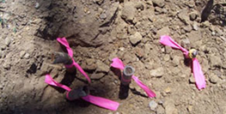
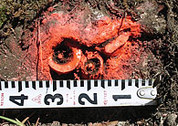
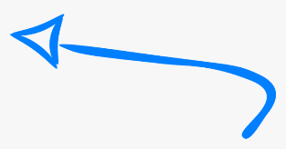
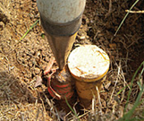
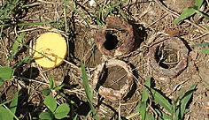
G. Adjustment Statistics; 2. Unknowns
    c. Adjustment Considerations
      (1) Pin cushion / monument nest?
~0.6’
0.50 sf
~0.8’

Slide 53
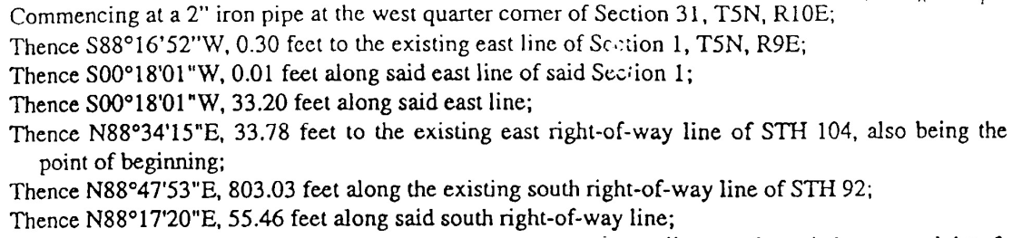
G. Adjustment Statistics; 2. Unknowns
    c. Adjustment Considerations
      (2) Noise level?
~0.6’
0.50 sf
~0.8’

Slide 54
Mentoring Mondays
Measurement & Computation Errors
I. Numbers
  A. Type
  B. Communication
  C. Sig Fig
II. Measurement Errors
  A. Quality
  B. Error Tenets
  C. Error Sources
  D. Error Types
  E. Behavior
  F. Minimizing
III. Random Errors
  A. Basic Analysis
  B. Error Propagation
IV. Least Squares Adj
  A. Compared to Simplified Adj
  B. Complex Networks
  C. Random Errors Only
  D. Redundancies
  E. Weights
  F. Linear/Non-Linear
  G. Adjustment Statistics

Slide 55
Mentoring Mondays
Measurement & Computation Errors
I. Numbers
  A. Type
  B. Communication
  C. Sig Fig
II. Measurement Errors
  A. Quality
  B. Error Tenets
  C. Error Sources
  D. Error Types
  E. Behavior
  F. Minimizing
III. Random Errors
  A. Basic Analysis
  B. Error Propagation
IV. Least Squares Adj
  A. Compared to Simplified Adj
  B. Complex Networks
  C. Random Errors Only
  D. Redundancies
  E. Weights
  F. Linear/Non-Linear
  G. Adjustment Statistics
A Whole Lotta Stuff!

