Slide 1

Riparian Concepts
6 April 2026
Jerry Mahun, PLS
Retired from Retiring
(I give up)
jerry.mahun@gmail.com
https://jerrymahun.com
715-896-3178

Slide 2
Riparian Concepts
A. Introduction
B. Public Trust Doctrine
C. Navigability
D. Terms
E. Riparian Ownership
F. Water Actions
G. Apportionment
H. Meander Corners
I. Reliction and Erosion

Slide 3

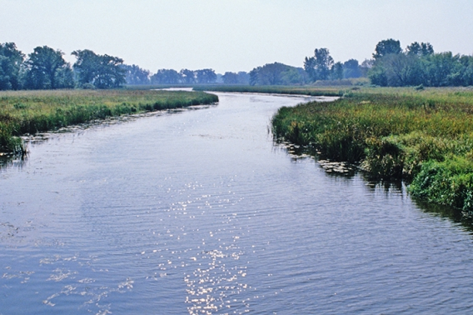

A. Introduction
Riparian – Of, relating to, or located on the bank of a river or stream; moving water.
Littoral – Of, or relating to, the coast or shore of an ocean, sea, or lake
Riparian right - Collective term for a riparian or littoral right.
Riparian owner – Owner of land abutting a waterway. Ownership may or may not extend under the water.
Riparian
Rights
Riparian
Littoral

Slide 4
A. Introduction
Riparian – Of, relating to, or located on the bank of a river or stream; moving water.
Littoral – Of, or relating to, the coast or shore of an ocean, sea, or lake
Riparian right - Collective term for a riparian or littoral right.
Riparian owner – Owner of land abutting a waterway. Ownership may or may not extend under the water.
Riparian
Rights
Warning:
Water law can vary greatly, even between adjacent states.
This presentation covers basic terminology and concepts.
A few notable jurisdictional differences are included to illustrate that "always" and "never" are terms to avoid when dealing with riparian rights.
Riparian
Littoral

Slide 5
B. Public Trust Doctrine
Black’s Law Dictionary
“The principle that navigable waters are preserved for the public use, and that the
state is responsible for protecting the public's right to the use.”
Roots go back to Roman law: res communes omnium “things held in common by all”
Things common to all humans (eg, air, flowing water) could not be privately owned, but they also were not owned solely by the state. The state held them in trust for the public to use.
Adopted in early English common law; specifically addressed in the Magna Carta, 1215:
“(33) All fish-weirs shall be removed from the Thames, the Medway, and throughout the whole of England, except on the sea coast.”
Fish-weirs obstructed navigation interrupting moving goods to market

Slide 6
B. Public Trust Doctrine
Article IV of the Northwest Ordinance of 1787 ordinance provides in part:
"...The navigable waters leading into the Mississippi and St. Lawrence, and the carrying places between the same, shall be common highways and forever free, as well to the inhabitants of the said territory, as to the citizens of the United States, and those of any other states that may be admitted into the confederacy, without any tax, impost, or duty therefor...
Martin v. Lessee of Waddell, 41 US 367 - Supreme Court 1842 first referred to it as a Public Trust.
States are primary Public Trust trustees of waters within & abutting their boundaries.
Degree of public protection and lands affected varies between states.
Most states are custodians of waters of all waterbodies, navigable or not, but only have ownership of beds of navigable waterways.

Slide 7

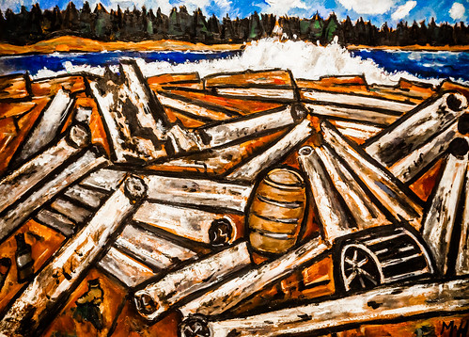

C. Navigability
Public Trust Doctrine exerts complete protection of navigable waterways.
What is Navigability?
Definition of navigability can vary between jurisdictions.
Evolved over time
What uses must it be able to support ?
Must it be able to continuously support that use?
Does it apply to natural waterways only or does it include artificial ones?
Strictly commerce
and transportation
Inclusive:
eg, recreation

Slide 8
D. Terms
OHWM – Ordinary High Water Mark
1. The point to which the presence and action of the water is so continuous as to leave a distinct mark either by erosion, destruction of terrestrial vegetation or other easily recognized characteristic.
2. Water surface at high tide for tidal waters.
OHWM
OHWM

Slide 9
D. Terms
OLWM – Ordinary Low Water Mark
1. The stage to which an inland waterbody recedes under ordinary conditions.
2. Water surface at low tide for tidal waters.
OHWM
OHWM
OLWM
OLWM

Slide 10
D. Terms
Bed – The ground surface between the OHWM on both sides of a waterway.
Bank – Area between water and OHWM. Right and left banks defined facing downstream.
Shore/shore land
1. Lands lying between the OWHM and OLWM for seas and tidal waters (aka Tidelands)
2. Lands below the OHWM for navigable rivers and lakes.
OHWM
OHWM
Bank
Bank
OLWM
OLWM
Bed

Slide 11
D. Terms
Thread - The centerline of a waterway, equidistant from the OHWM on both sides.
Thalweg (Talweg) – A line along the deepest channel of a waterway.
In some jurisdictions, the thalweg is the waterway centerline, ie, thread.
midway
OHWM
Thread
Thalweg
OHWM
Bed

Slide 12



E. Riparian Ownership
Navigability affects bed ownership.
Generally, bed of a non-navigable waterway belongs to the upland riparian owners.
Ownership extends to thread or thalweg depending on jurisdiction or description wording.
OHWM
Thread
Thalweg
OHWM
Although the bed of a non-navigable waterbody belongs to the riparian adjoiner, the state still has authority over the water itself.
Bed

Slide 13
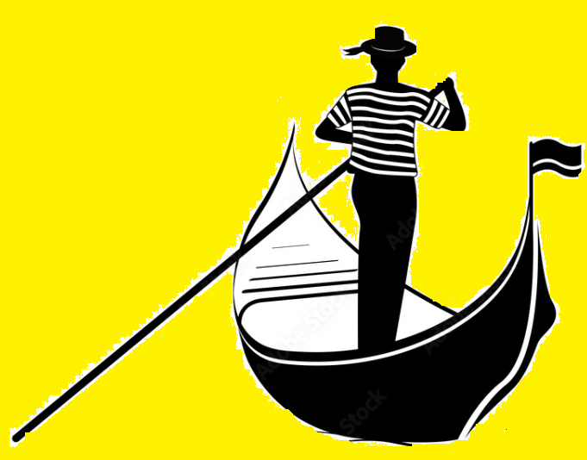
E. Riparian Ownership
Navigability affects bed ownership.
Beds of navigable waterways theoretically belong to the public and riparian ownership ends at the OHWM or OLWM.
Public
OHWM
OHWM
Bed

Slide 14
E. Riparian Ownership
Navigability affects bed ownership.
But that’s not universal,
In Wis, for example, navigable lake beds belong to the public, but navigable stream and river beds belong to the upland riparian owners extending to the thread.
Littoral v. Riparian
OHWM
Thread
OHWM
Bed

Slide 15
E. Riparian Ownership
Navigability affects bed ownership.
Riparian owner has limited reasonable use of waterbody that does not conflict with public use.
For example: cannot erect barriers across a navigable stream obstructing kayaking.

Slide 16
E. Riparian Ownership
What about artificially created navigable waterbodies? Who owns the bed?
Waterbodies created on private land are not subject to public bed ownership.
Nor are the waters subject to public use.
Navigable waterway
Artificial
lake

Slide 17
E. Riparian Ownership
What about artificially created navigable waterbodies? Who owns the bed?
Waterbodies created on private land are not subject to public bed ownership.
Nor are the waters subject to public use.
However, if the artificial waterbody is connected to a navigable waterway, it can be subject to public use.
Navigable waterway
Artificial
lake

Slide 18
F. Water Action
1. Boundary
Water as a property boundary is a natural monument.
Under certain conditions, water is the only monument that can legally change position over time changing ownership extent.

Slide 19
F. Water Action
2. Movement
a. Reliction: The gradual and imperceptible movement of water uncovering previously submerged land.
Also known as dereliction.
b. Avulsion: The sudden relocation of a waterbody either by a catastrophic event or rapid erosion.
3. Land
a. Erosion: Land area removal caused by water action.
b. Accretion: Gradual land area increase due either to reliction or soil deposits
c. Alluvium: Deposited material.

Slide 20
F. Water Action
4. Effect on Ownership
a. A sudden change does not affect ownership: Avulsion.
Example: non-navigable stream.
[A] Ownership extends to thread/thalweg.
[B] Heavy storms, bank collapses causing stream location to shift.
[C] Ownership does not change: extends to original thread/thalweg location
[A]
[B]
[C]

Slide 21
F. Water Action
4. Effect on Ownership
b. Slow imperceptible changes do affect ownership extent.
There are a few types of slow imperceptible changes:
(1) Water naturally recedes over time uncovering land – ownership expands
(2) Water level gradually increases submerging land – ownership decreases.
Water boundary change must be permanent.
(2)
boundary
boundary
(1)

Slide 22
F. Water Action
4. Effect on Ownership
b. Slow imperceptible changes do affect ownership extent.
There are a few types of slow imperceptible changes:
(3) Erosion over time removes land – ownership decreases
(4) Soil deposited by moving water – ownership increases
(3)
(4)
(4)
(3)

Slide 23

G. Apportionment
1. Riparian Ownership
When land is gained or lost by water actions, it rarely affects just a single property.
Apportionment is a method by which land gained is divided among the affected parcels along navigable waterbodies.
There is no single universal apportioning method.
There are a few different methods.
Which to apply depends in large part on the waterbody type, shape, or size.
In some cases, a combination of methods may be reasonably applied.
Apportionment is not an exact science:
Two surveyors applying the same method may have different results.
Following are some of the more common methods.

Slide 24
G. Apportionment
1. Streams
a. Perpendicular Method - project lines perpendicular to either
(1) new shoreline
(2) new thread/thalweg
Senior/Junior relationships may have to be considered
along ends.
previous shore
(1) new shore
(2) new thread/thalweg

Slide 25
G. Apportionment
1. Streams
b. Proportion: Based on lengths of original and new shorelines.
a=A(L_{old}/L_{New}), etc. L_{Old}, L_{New}: old and new shoreline lengths
A
C
B
D
a
c
b
d
previous shore
new shore

Slide 26
G. Apportionment
2. Lakes
a. Round Lake Method; aka Pie Method
Applicable to lakes that are roughly circular.
A “center” point is selected and property lines are projected to its direction.
Center point location is one which adds a roughly proportional amount of area to each property.

Slide 27
G. Apportionment
2. Lakes
b. Long Lake Method
This is a variation on the perpendicular stream method.
Along the lake’s length lines are projected perpendicular to the thread or new shore,
At the lake ends, the round lake method is used.

Slide 28
H. Meander Corners
1. PLSS Meander Corners (MC)
a. Placed where a regular line intersected a meanderable waterbody.
- Can be used to re-est lost corners.
- Can control line direction.
Line is a continuation and in cardinal direction.
b. Placed along waterbody.
To map the waterbody
In both cases, the MC is not a property corner; waterbody is.
NE Cor
MC: 77.63 ch
E1/4: 40.00 ch
MC
MC
MC: 27.10 ch
MC: 15.85 ch
MC
SE Cor
MC
MC.1
MC.2

Slide 29
H. Meander Corners
2. Non-PLSS MC
Boundary creation: Surveyors typically set MC on a parcel line that intersects navigable waterbody.
Like PLSS MC.a, these can control line direction if called; waterbody is termination
Unlike PLSS MC.a, line through MC is not necessarily a continuation nor restricted to cardinal dir.
Lot 14
Lot 15
Lot 13
MC
Lot 12

Slide 30
H. Meander Corners
2. Non-PLSS MC
Boundary creation: Surveyors typically set MC on a parcel line that intersects navigable waterbody.
Example: Reliction
Extend property lines straight through MC until they intersect the shore or thread/thalweg?
Lot 14
Lot 15
Lot 13
MC
Lot 12

Slide 31
H. Meander Corners
2. Non-PLSS MC
Boundary creation: Surveyors typically set MC on a parcel line that intersects navigable waterbody.
Example: Reliction
Extend property lines straight through MC until they intersect the shore or thread/thalweg?
Based on how the water’s edge changes, extended lines might cross.
Lot 14
Lot 15
Lot 13
MC
Lot 12

Slide 32
H. Meander Corners
2. Non-PLSS MC
Boundary creation: Surveyors typically set MC on a parcel line that intersects navigable waterbody.
Example: Reliction
Better to use one of the other apportioning methods.
When proportioning, use the shore distances, not distances between MCs
Lot 14
Lot 15
Lot 13
Yes
No
MC
Lot 12

Slide 33
I. Reliction & Erosion
1. Reliction
a. Example One
Over a 29 year period lake depth gradually increases causing shore to move inland.
Lake level stabilizes and shore maintains its location through today.
Because this is a permanent change, the parcels are remainders as shown, with one parcel completely gone.
1961
1976
2026
1990

Slide 34
I. Reliction & Erosion
1. Reliction
b. Example Two
Over a 29 year period lake depth gradually increases causing shore to move inland.
Is stable for a few years, then lake level slowly decreases causing shore to recede, after which it stabilizes.
Boundaries ?
1961
2026
1976
1992
1990

Slide 35
I. Reliction & Erosion
1. Reliction
b. Example Two
Over a 29 year period lake depth gradually increases causing shore to move inland.
Is stable for a few years, then lake level slowly decreases causing shore to recede , after which it stabilizes.
Because this is not permanent reliction, the original parcels are recreated with some addition/loss along present shoreline.
1961
1961
2006
1976
1992
1990

Slide 36
I. Reliction & Erosion
2. Erosion
a. Example One
Over a 21 year period river flow erodes the bank causing shore to move.
Bank stabilizes and maintains its position.
Eroded lands are gone, in some cases removing entire parcels, in others leaving behind remnants. Some previously inland parcels now have water frontage.

Slide 37
I. Reliction & Erosion
2. Erosion
b. Example Two
Over a 21 year period river flow erodes the bank causing shore to move.
Shore is stable for a few years after which sedimentation begins to accumulate and continues up through today.
Depending on jurisdiction....

Slide 38
I. Reliction & Erosion
2. Erosion
b. Example Two
Over a 21 year period river flow erodes the bank causing shore to move.
Shore is stable for a few years after which sedimentation begins to accumulate and continues up through today.
Depending on jurisdiction....
The original parcel boundaries are recreated to the new shore line.

Slide 39
I. Reliction & Erosion
2. Erosion
b. Example Two
Over a 21 year period river flow erodes the bank causing shore to move.
Shore is stable for a few years after which sedimentation begins to accumulate and continues up through today.
Depending on jurisdiction....
Alluvium is apportioned to the parcels with frontage on the eroded bank.

Slide 40
Riparian Concepts
Summary
Public Trust Doctrine
Waters; navigable waterways
Navigable v Non-navigable
Terminology
Water movement boundary effect
Sudden vs. Slow & Imperceptible
Apportionment
Meander corners
Reliction and Erosion Examples
Loss; Re-establishment; Acquisition
Questions?

